Slide 1
A description of the problem and a discussion of the background
Hyderabad, The city of Nizams is one of the oldest cities not just in India but in the world. A city that has almost everything to offer its visitors, Hyderabad makes for one of the most interesting places to visit. A blend of rich cultural and historical heritages, age old traditions and best of modern facilities, the city of Hyderabad presents an environment that is unmatched to any. Another important aspect of a trip to Hyderabad is its cuisine. Hyderabad cuisines, and the world famous biryani will pamper your palate in the best way possible.
With a history of almost 400 years, the city of Hyderabad has been ruled by the Qutub Shahis. The name of Hyderabad has a history behind it. It had the name of Bhagyanagar which was named after Bhagyamati. Later as she became Hyder Mahal as the wife of Quli Qutub Shah, which led to the birth of Hyderabad. The Kingdom of Golconda was founded by Qutb Shahi Dynasty after the break up of Bahamani Kingdom. The Deccan has been ruled by the Qutb Shahis for approximately 171 years. This has also given the place its Indo-Persian and Indo-Islamic culture and literary background and we showcase all these with our Hyderabad Tour Packages.
Looking at the geographical location, Hyderabad, the capital city of Andhra Pradesh and the fifth largest city in India, is located at a latitude of 17o E 22’ N and longitude of 78 o 27’. The city is well connected to various cities and rest of the country.
I would like to open a chat Restaurant in the Hyderabad. Here are the few Questions that can be asked in order to identify the best location for our restaurant.
Which Hyderabad area has more restaurants?
What is best location in Hyderabad City for Indian Chaat?
Which areas have large number of Chat restaurant?
Which all areas have less number of Chat restaurant?

Slide 2
Data to be used for finding best location for Chaat restaurant in Hyderabad
Hyderabad Restaurants data consisting of Locality, Restaurant name, Rating, latitude and longitude.
Hyderabad Restaurant/Venus Dataset :
https://www.kaggle.com/ramanchandra/bangalore-hyderabad-venue-dataset?select=Hyderabad_venues.csv
We will need to extract Locality, Restaurant name, Rating, latitude and longitude columns/data from the above dataset link. This data set will help us to explore various localities of Hyderabad city.
We will use Foursquare API to explore nearby places/venues in each neighborhood in Hyderabad city
Data analysis steps:
We will collect the Restaurant data from kaggel dataset
We will use FourSquare API to find all venues for each neighborhood.
We need to filter out all venues that are nearby by locality.
We will use the restaurant ratings to identify the best places.
We will visualize the Ranking of neighborhoods using folium library

Slide 3


Target Audience: This analysis will be mainly useful for the individual who would like to open a Chaat Restaurant in Hyderabad city. Chaat images:

Slide 4
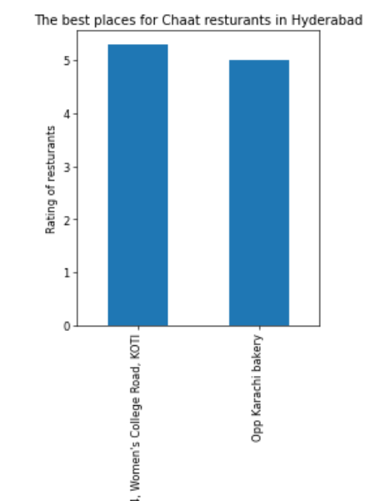
Best place for chat in Hyderabad

Slide 5
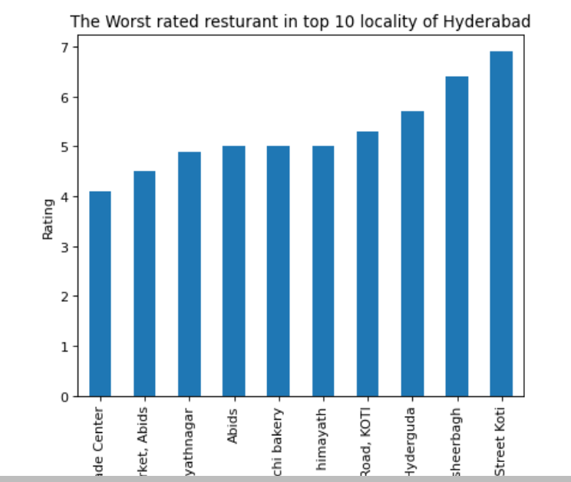
The worst restaurants are available in Himayath nagar

Slide 6
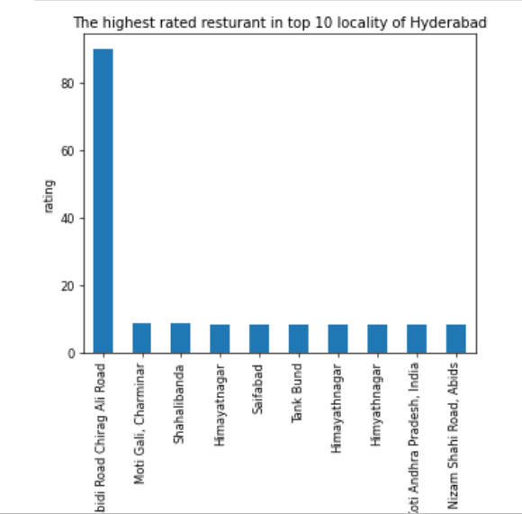
The best restaurants are available in Chirag Ali road in hyderabad

Slide 7
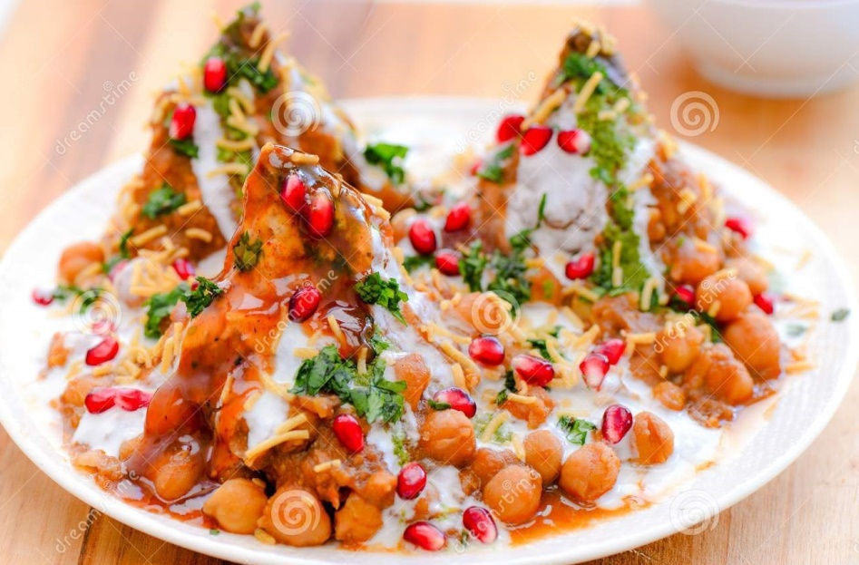
Conclusion
Best restaurants are available in Chirag Ali road
The worst restaurants are available in Himayath nagar
Best places for chaat restaurant in Hyderabad are College Road, Koti & Opp Karachi Bakery

